Slide 1
Lab 5 Demonstration An Application of Probability Distributions
STAT 201: Elementary Statistics
Imtiaz Ebna Mannan

Slide 2
Introduction
Insurance companies use probability models to quantify uncertainty and predict outcomes in the long run. These probability models guide the company in developing insurances plans with a high likelihood of profit in the long run.
This lab –
Passengers of a luxury Mediterranean cruise that costs $3000 have the option to purchase travel insurance.
This insurance will cost them $350.
With the insurance if the passenger needs to cancel their cruise for either of the following two reasons, they will get their $3000 back:
Reason 1 – personal – illness, work, family emergency, etc.
Reason 2 – flight cancellation/delay and they miss the cruise.

Slide 3
From the Customer’s Perspective
The customer decides to purchase the $350 insurance.
They have had bad experiences before with flights and you are concerned something personally might come up and they will miss the cruise.
Even though it seems costly they are going to pay the $350 in order to make sure they get their $3000 back in case they miss the flight (i.e. they are only out $350).
If they didn’t get the insurance and they weren’t able to go on the trip they would be out $3000.

Slide 4
From the Insurance Company’s Perspective:
The company estimates the following:
5% of customers with the insurance will not be able to travel for personal reason.
4% of those that are able to travel (regardless of the personal reasons) will not make the cruise because their flights might be cancelled or delayed.
If the customer that has paid for the insurance and is able to go on, the cruise the company gains $350 (from the insurance that the traveler has purchased).
If the customer that has paid for the insurance and is not able to go on the cruise the company loses $2650 ($3000 - $350).
THE PURPOSE OF THIS LAB – the insurance company is reviewing the current cost of the package.

Slide 5
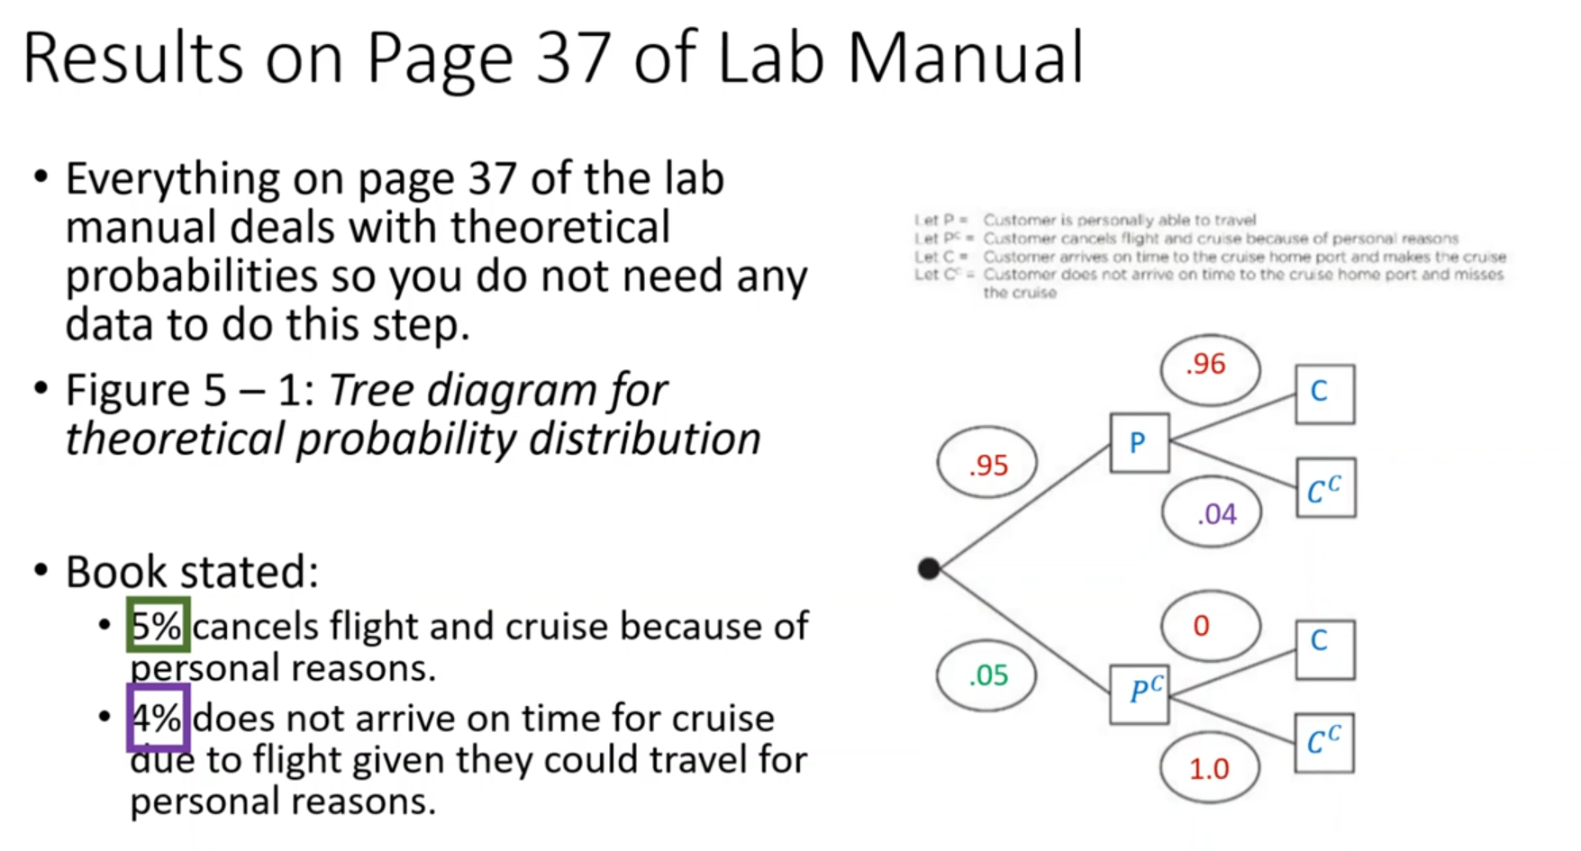

Slide 6
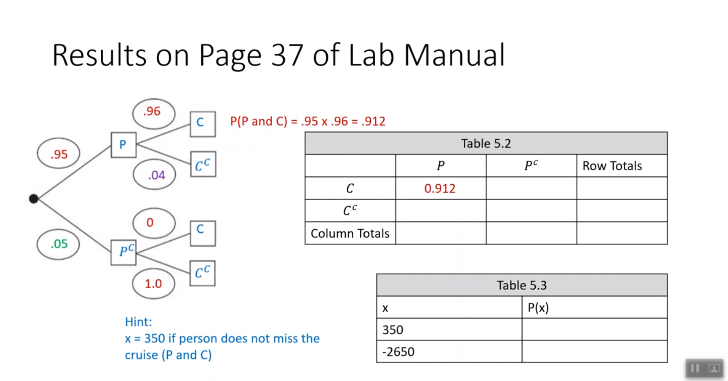

Slide 7
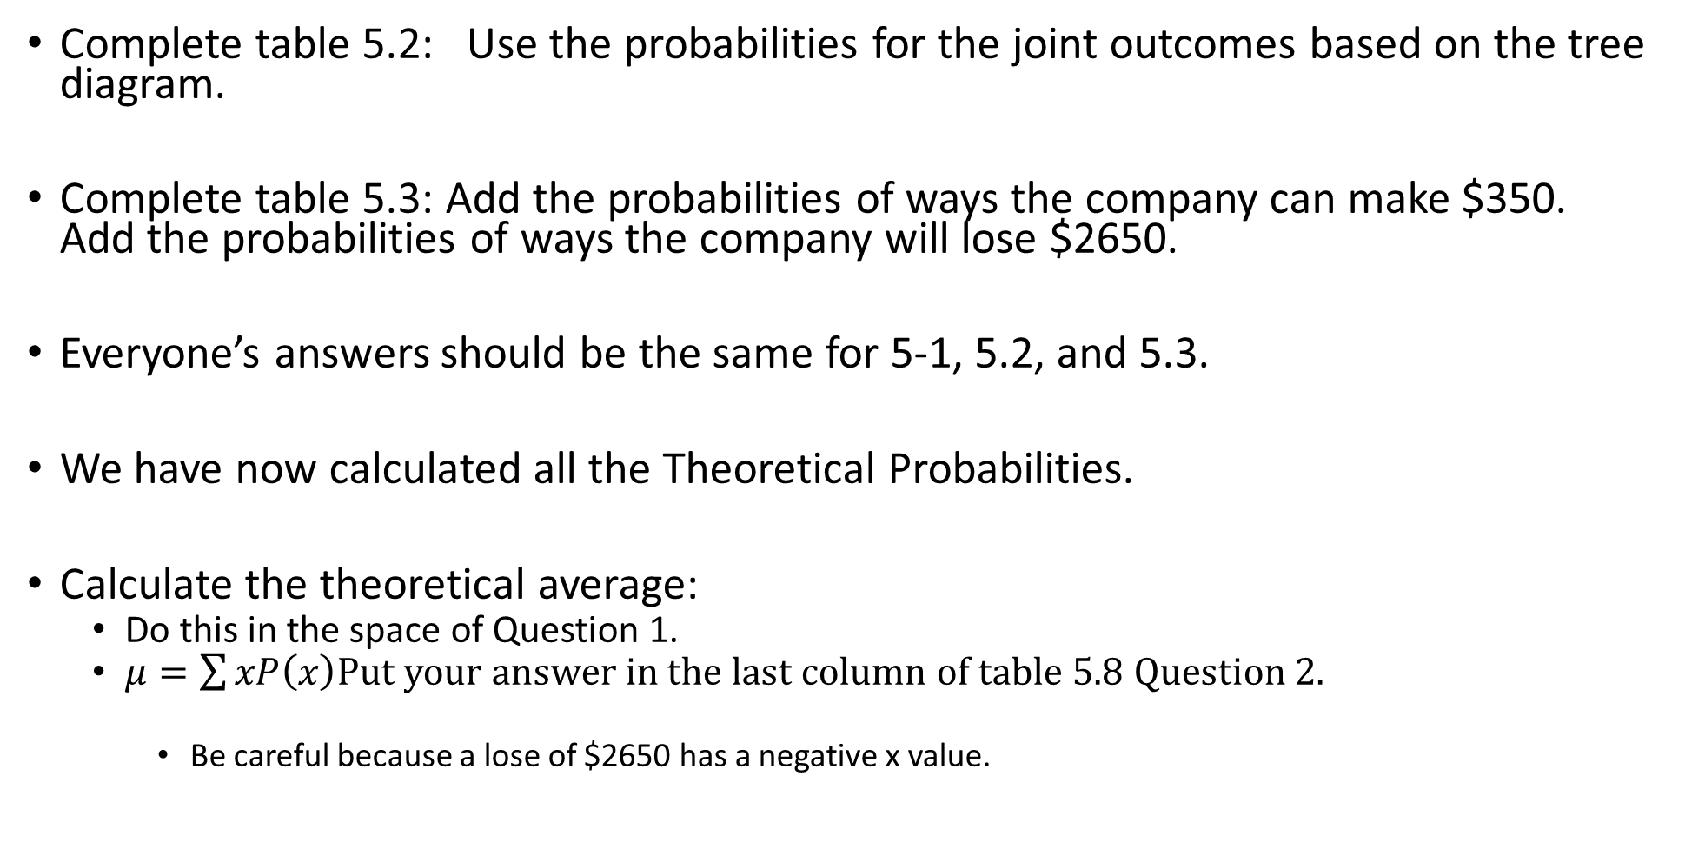
Complete table 5.2: Use the probabilities for the joint outcomes based on the tree diagram.
Complete table 5.3: Add the probabilities of ways the company can make $350. Add the probabilities of ways the company will lose $2650.
Everyone’s answers should be the same for 5-1, 5.2, and 5.3.
We have now calculated all the Theoretical Probabilities.
Calculate the theoretical average:
Do this in the space of Question 1.
$μ=\sum{xP\left(x\right)}$Put your answer in the last column of table 5.8 Question 2.
Be careful because a lose of $2650 has a negative x value.

Slide 8
Simulations of the Cruise Scenario
Working in groups of 2/3/4. Depending on your lab scenario, you will decide what is best number.
There are two buckets on your table:
Bucket 1: Travel
19 Can Travel Beads and 1 Can’t Travel Beads.
Gently shake the bucket to mix the beads and without looking draw one bead at random.
If can travel bead then draw from the flight bucket.
If can’t travel bead then you can’t travel for personal reasons.
Bucket 2: Flight
24 On Time Beads.
1 Cancelled/Delayed Bead.
IF YOU ARE ABLE TO TRAVEL FOR PERSONAL REASONS then gently shake the bucket and without looking draw a bead at random.
If on time bead then you are able to make the cruise.
If cancelled/delayed bead then you are not able to make the cruise.
One person draws and their partner records the results for them.
Each person will draw 25 times and record results in Table 5.4:
Note value in the column Insurance Company profit will be either:
$350 – if you make the cruise.
-$2650 if you can’t make the cruise. (regardless of reason).
After both lab partners have data each needs to calculate the data in table 5.5.
The mean calculated will go in the first column of table 5.8 Question 2.

Slide 9
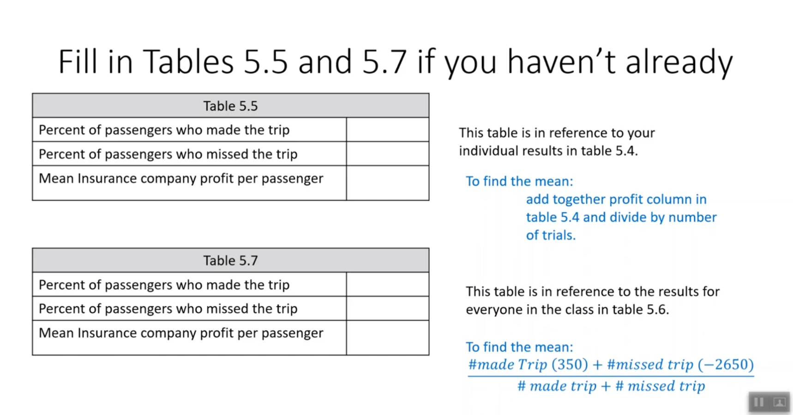

Slide 10
Combined Trails for all Students
One at a time each person/group will tell me total number passengers that made the trip.
The values will be on the screen and calculated in Excel.
After all data is combined fill in table 5.7.
The mean calculated will go in the middle column in table 5.8 Question 2.

Slide 11
In the Results:
Everything on pages 37-39 should be filled in.
Discussion Questions:
Questions 1 and 2 should be complete.
Question 5 – read the reality check on page 35.

